Slide 1
Chapter 1
Financial Market
(To examine how financial institutions such as banks, investment and insurance companies work)
Notes:
If this PowerPoint presentation contains mathematical equations, you may need to check that your computer has the following installed:
1) MathType Plugin
2) Math Player (free versions available)
3) NVDA Reader (free versions available)

Slide 2
Learning Objectives
Recognize the importance of financial markets in the economy.
Describe how financial intermediation and financial innovation affect banking and the economy.
Explain the importance of exchange rates in a global economy.

Slide 3
Financial Markets
Financial markets are markets in which funds are transferred from people and firms who have an excess of available funds to people and firms who have a need of funds

Slide 4
The Bond Market and Interest Rates
A security (financial instrument) is a claim on the issuer’s future income or assets.
A bond is a debt security that promises to make payments periodically for a specified period of time.
An interest rate is the cost of borrowing or the price paid for the rental of funds.

Slide 5
The Stock Market
Common stock represents a share of ownership in a corporation.
A share of stock is a claim on the residual earnings and assets of the corporation.

Slide 6
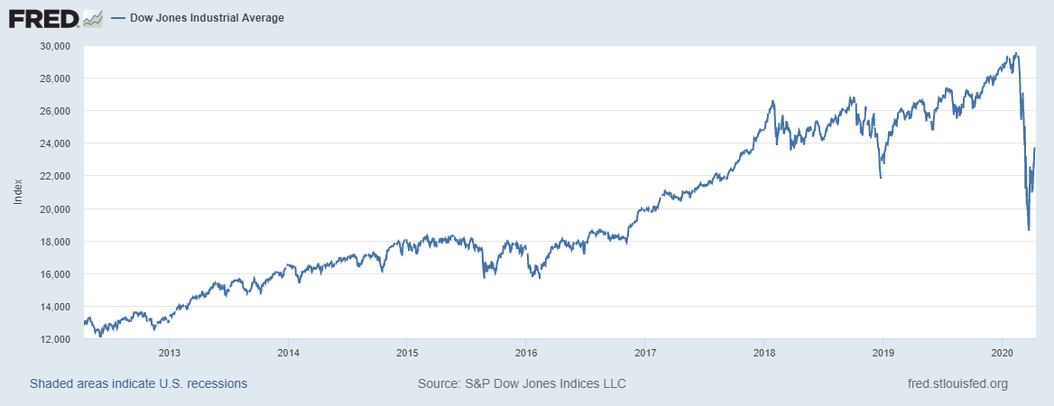
Figure 2 Stock Prices as Measured by the Dow Jones Industrial Average, 2012–2020

Slide 7
Why Study Financial Institutions and Banking? (1 of 2)
Financial intermediaries: institutions that borrow funds from people who have saved and in turn make loans to people who need funds.
Banks: accept deposits and make loans
Other financial institutions: insurance companies, finance companies, pension funds, mutual funds and investment companies
Financial innovation: the development of new financial products and services
e.g., the improvement of information technology leads to the ability to deliver financial services electronically (e-finance)

Slide 8
Why Study Financial Institutions and Banking? (2 of 2)
Financial innovation: the development of new financial products and services
Can be an important force for good by making the financial system more efficient
E-finance: the ability to deliver financial services electronically
Financial crises: major disruptions in financial markets that are characterized by sharp declines in asset prices and the failures of many financial and nonfinancial firms.

Slide 9
Why Study Money and Monetary Policy?
Evidence suggests that money, defined as anything that is generally accepted as payment for goods or services or in the repayment of debts, plays an important role in generating business cycles.
Recessions (unemployment) and expansions affect all of us.
Monetary theory ties changes in the money supply to changes in aggregate economic activity and the price level.

Slide 10
Money, Business Cycles, and Inflation
The aggregate price level is the average price of goods and services in an economy
A continual rise in the price level (inflation) affects all economic players
Data show a connection between the money supply and the price level
NOTE: Visit www.tradingeconomics.com for latest data/charts

Slide 11
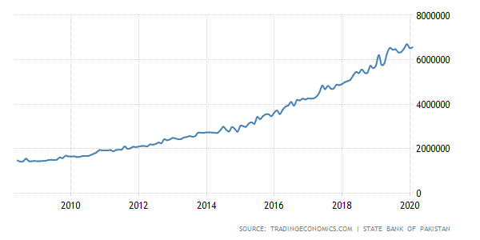
Pakistan Money Supply M02008-2020

Slide 12
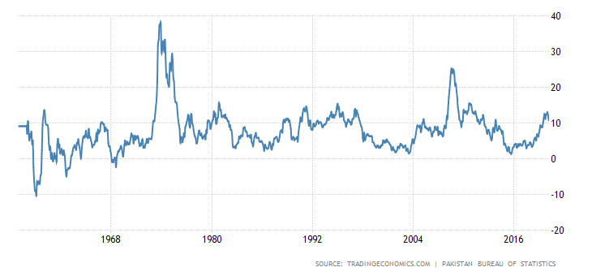
Pakistan Inflation Rate

Slide 13
Fiscal Policy and Monetary Policy
Monetary policy is the management of the money supply and interest rates
Conducted in the SBP
Fiscal policy deals with government spending and taxation
Budget deficit is the excess of expenditures over revenues for a particular year
Budget surplus is the excess of revenues over expenditures for a particular year
Any deficit must be financed by borrowing

Slide 14
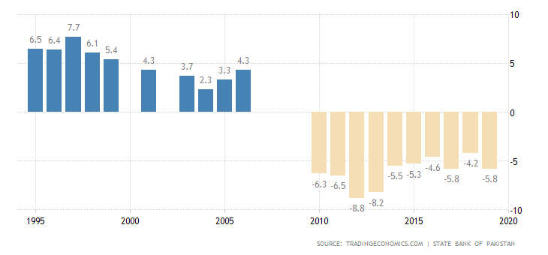
Figure 7 Government Budget Surplus or Deficit as a Percentage of Gross Domestic Product, 1995–2019

Slide 15
The Foreign Exchange Market
The foreign exchange market: where funds are converted from one currency into another
The foreign exchange rate is the price of one currency in terms of another currency.
The foreign exchange market determines the foreign exchange rate.

Slide 16
Why Study International Finance
Financial markets have become increasingly integrated throughout the world.
The international financial system has tremendous impact on domestic economies:
How a country’s choice of exchange rate policy affect its monetary policy?
How capital controls impact domestic financial systems and therefore the performance of the economy?
Which should be the role of international financial institutions like the IMF?

Slide 17
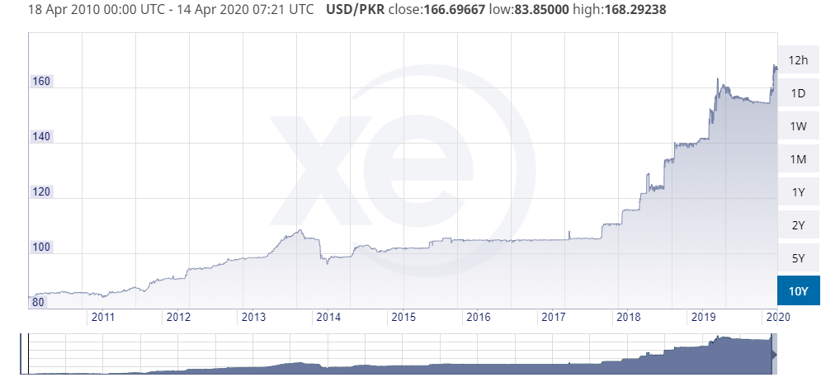
Figure 8 Exchange Rate of the PKR against USD, 2010–2020
Source: https://www.xe.com/currencycharts/?from=USD&to=PKR&view=10Y

Slide 18
The International Financial System
Financial markets have become increasingly integrated throughout the world.
The international financial system has tremendous impact on domestic economies:
How a country’s choice of exchange rate policy affect its monetary policy?
How capital controls impact domestic financial systems and therefore the performance of the economy?
Which should be the role of international financial institutions like the IMF?
(Will discuss in later Chapters)

